Slide 1
Improved inter-departmental communication
Project Database

Slide 2
Current communication structure
Communication is People Eccentric NOT System Eccentric
Heavy reliance on Excel worksheets
Duplication of efforts
Dependent upon interconnected updates from other departments
Requires cross-checks on data to ensure it is current
No Centralization of Information or Documents
There are centralized People with information or documents (MAFIA STRUCTURE)
Risk to Company should employee be no longer affiliated with company
Handover for Projects or “New” Positions is marginal at best
Inefficient and will become problematic as company grows!

Slide 3
GENERAL Information structure
EMKAN HOLDINGS
Medicine Factory
Concrete Factory
Petro-V
Al Essa
SAMIF
Project Management
PRIMARY ASSETS
Manpower
Equipment
Documentation DataBase
(Master Templates)

Slide 4
DISCRETE LOOP - MANPOWER
Project Management
Manpower Control Team
Quality Team
Planning /
Support Team
Safety Team
Construction Team
Manpower
Rental
Direct Hire
IQAMA
EMP #
Salary
Job Title
Certifications
Etc.
PRIMARY ASSET

Slide 5
DISCRETE LOOP - EQUIPMENT
Project Management
Construction Team
Planning /
Support Team
Manpower Control Team
Asset Management
Rental
Purchase
ESTAMARA
MVPI
Inspections
Calibrations
Operators
Etc.
Equipment
PM Schedule
Repair Costs
Etc.
PRIMARY ASSET

Slide 6
DISCRETE LOOP - DOCUMENTATION
Project Management
Quality Team
Safety Team
Required Project Documents
Planning /
Support Team
Construction Team
Documentation DataBase
(Master Templates)
ARAMCO PROJECT TEAM
Bid Submission
Execution Plan
Mobilization Plan
PQP, HIP, Etc.
PRIMARY ASSET

Slide 7
COMMUNICATION ROAD MAP
PMO
Contract Review
Review Pre-Plan Strategy
Input Key Reqmts
Contracts Dept
Have Key Personnel?
Construction Activities
Internal
Kick-Off Meeting
YES
Bid NOI Create File?
Have Req’d Equipmt?
YES
NO
NO
Project Documents
External
Kick-Off Meeting
NO
YES
Identify Gaps
Assets
Rental or
Purchase
Job Ex
Site Visit
Notes in File
Plans/Reports To ARAMCO
Submit Bid?
QA/QC Team
Safety Team
Construction Team
Support/Planning Team
NO
YES
ARAMCO Submission Accepted?
YES
NO
Direct Hire?
MPC Feedback
Documentation Database
Provide Bid Pkg to Operations
(Pre-Plan Stratgy)
YES
NO
Engage Rental Agency
Revise/Edit
Report/Plan
Awarded Contract?
NO
YES
YES
Hired Key Persons?
NO

Slide 8
STRUCTURE TO USING DATABASES
There will be 2 Primary Databases with each Project having its own DataBase
Primary DataBases
Company DataBase
Documentation DataBase
Secondary DataBases
Every Project
DOCUMENTATION
DATABASE
COMPANY DATABASE
Manpower
Equipment
Documentation DataBase
(Master Templates)
Projects
PROJECT DATABASE

Slide 9
COMPANY database

Slide 10
Control the resources of the company
Manpower
Equipment
Documentation – to be a separate database that will be linked to specific Projects

Slide 11
manpower
Available and Balance Discipline
Location
Nationality
Iqama & Safety card expire date
Rental
Cost

Slide 12
equipment
Available and Balance.
Last maintains date.
Status
MVPI & ESTMARA & INSPECTION STICKER expire date.
Users (Operators)
Rental
Cost.

Slide 13
PROJECT database

Slide 14
Main purpose is to Close the communication gape between the following department:
1- Contracts
2- PMO
3-Manpower control
4-Logistics
5-Quality
6-Safety
7-Procurement
8-Aramco Documentation

Slide 15
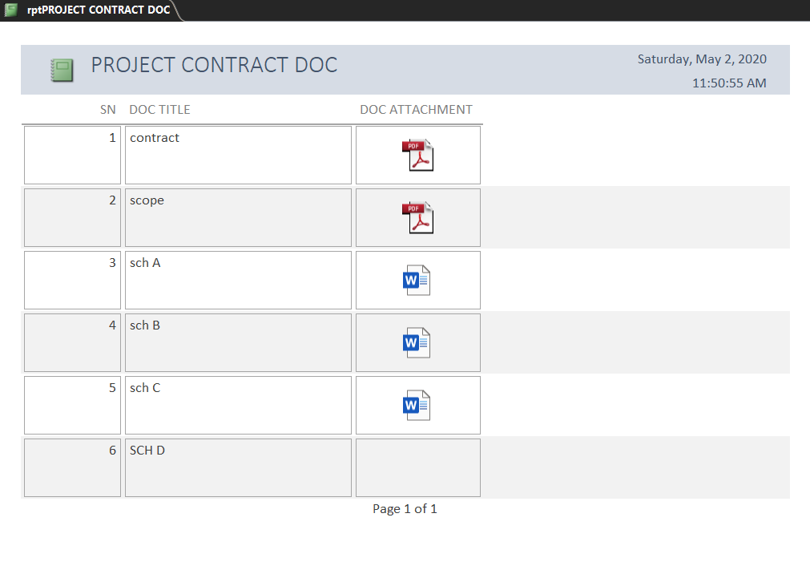
Contracts
Attach all documents related to the project and pass it to the project manager.

Slide 16
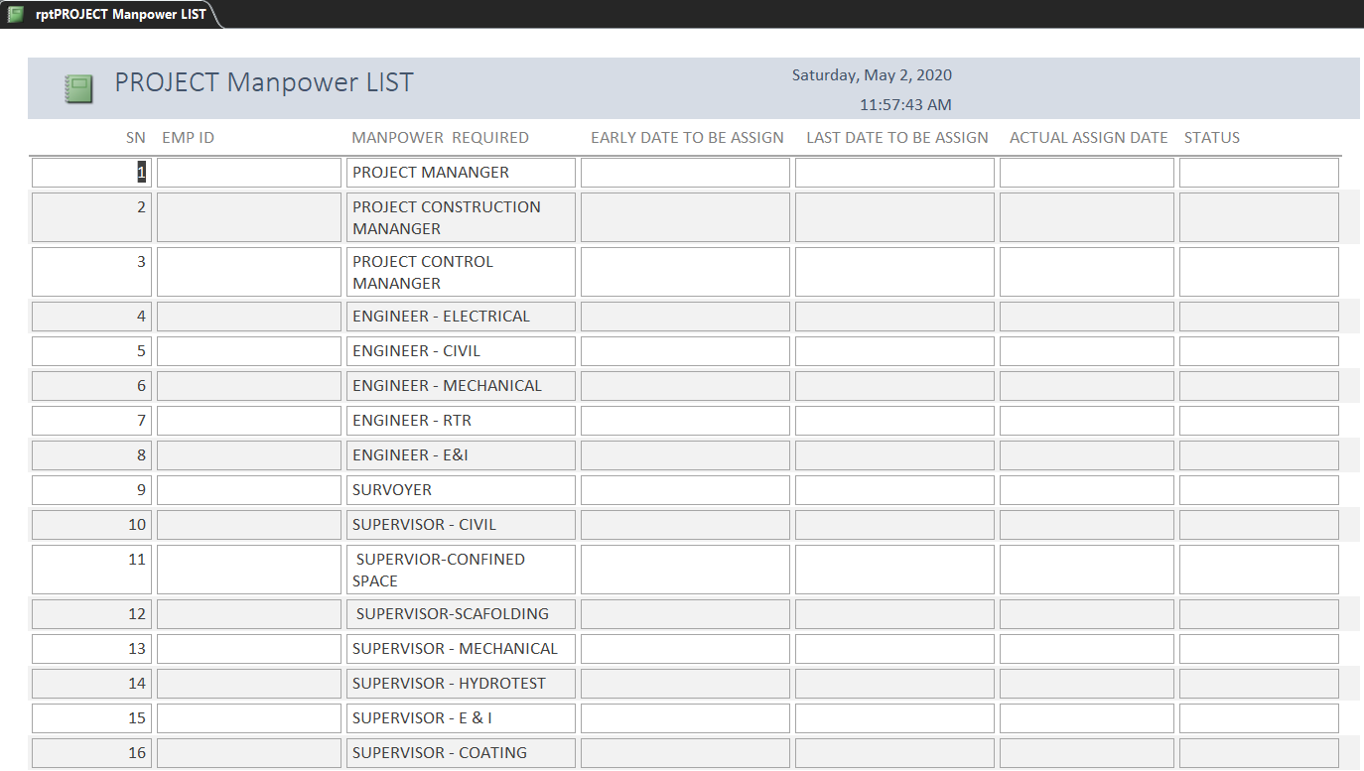
PMO
Manpower

Slide 17
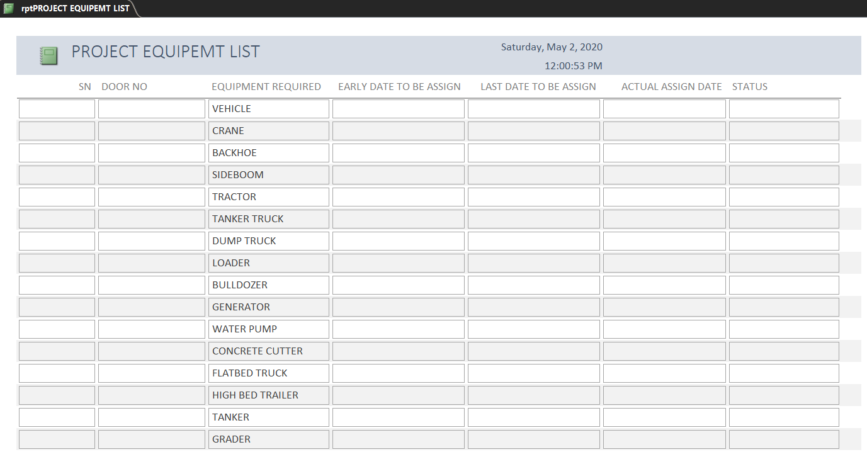
Equipment

Slide 18
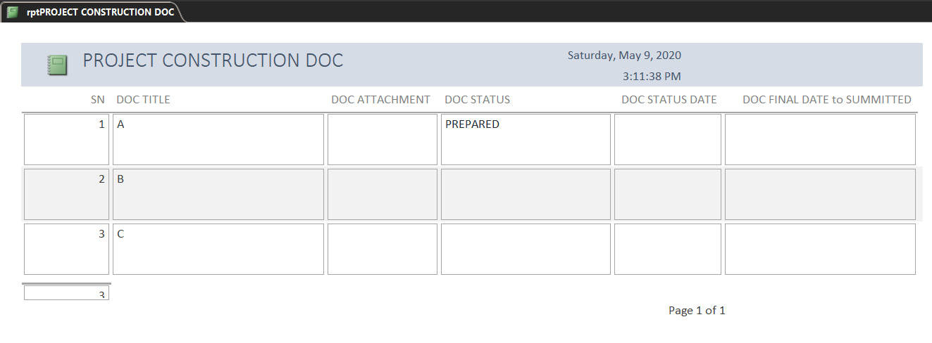
Construction DOC

Slide 19
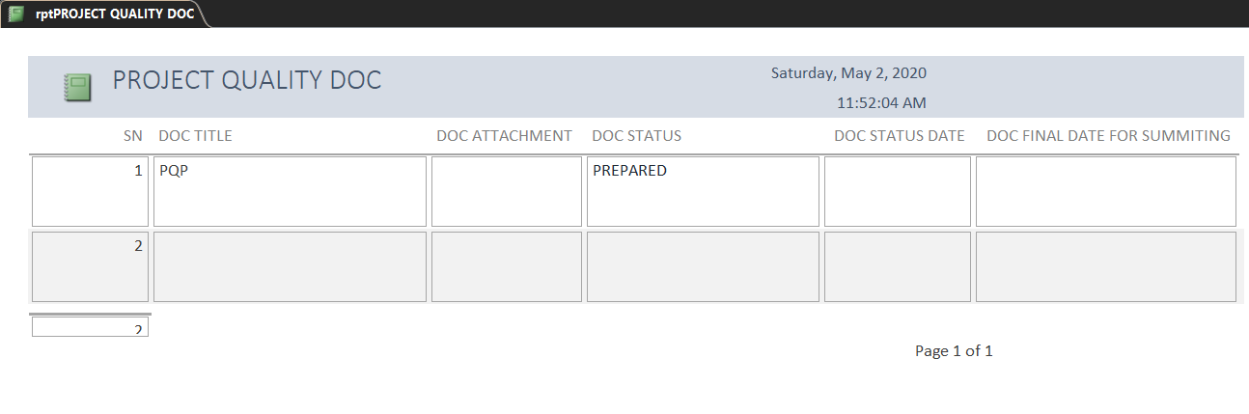
Quality

Slide 20
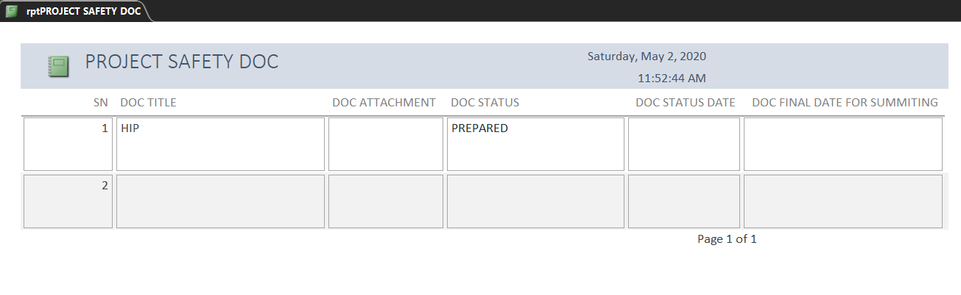
Safety

Slide 21
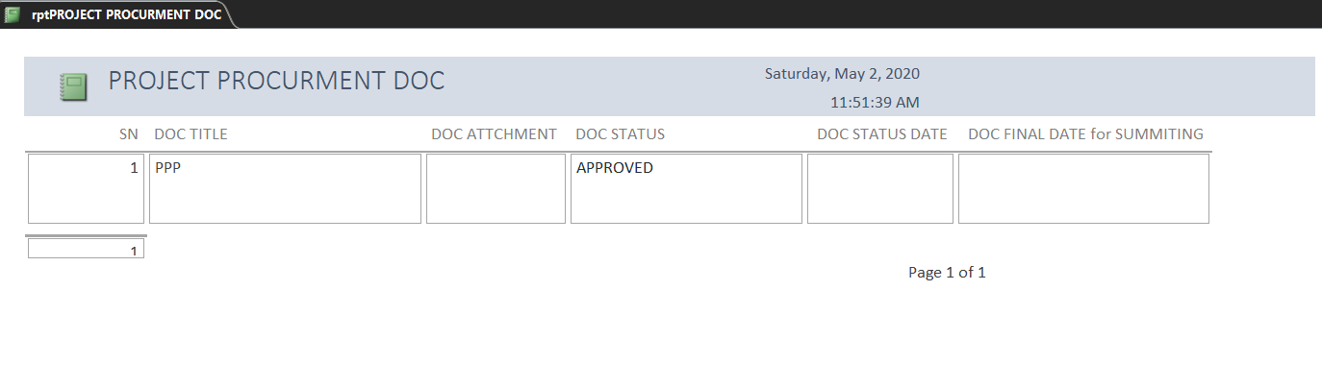
Procurement

Slide 22
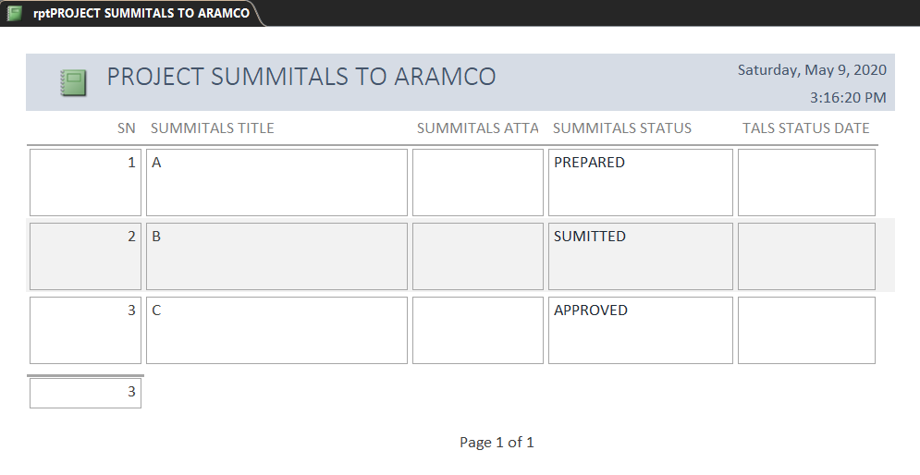
Aramco Doc.

Slide 23
CONTRACTS
PMO
MANPOWER
EQUIPMENT
DOCUMENTS
QUALITY
SAFETY
CONSTRACTION
DIRECT HIRE
RENTAL
QUALITY
SAFETY
CONSTRUCTION
PLANING
PROCURMENT
ARAMCO DOC
DIRECT HIRE
RENTAL
TECHNICAL &PLANING
QUALITY
SAFETY
CONSTRACTION
TECHNICAL &PLANING

Slide 24
Path forward
Petro-V to utilize initially
Implement Databases within targeted groups with Al Essa
Customized System Developed for EMKAN and Group of Companies
Hire a Programmer
Programmer to develop other software for future growth (PM Tracking, etc)
IF WE DO NOTHING – OUR FUTURE IS LIMITED

